Slide 1

EARLY EPILEPSY SEIZURE DETECTION
An Explainable Deep Learning Pipeline for Scalp EEG
CHB-MIT Scalp EEG Database • 1D CNN • SHAP Explainability
Wasnik Aishwary Manoj (23115111) • Vivek Anand (23115109)
Guided by Dr. Bunil Kumar Balbantaray
Final Year Project — Computer Science & Engineering
National Institute of Technology, Raipur

Slide 2



WHY THIS PROBLEM MATTERS
Seizures are unpredictable — detection needs to be automatic
50M+
24/7
0
people worldwide live with epilepsy
continuous EEG monitoring is needed to catch seizures
black-box alerts a clinician can trust without explanation
This project builds a full pipeline — from raw EEG to a seizure prediction — with an explainability layer so a clinician can see which channels and moments drove each call.

Slide 3
THE DATASET
CHB-MIT Scalp EEG Database
PhysioNet • Pediatric epilepsy patients • Continuous scalp EEG recordings
23
256 Hz
5
EEG channels per recording
original sampling rate
subjects processed so far (of 23)
315,686
0.27%
843
4-second windows built
of windows are true seizure activity
seizure windows across all subjects
The 0.27% seizure rate is the central challenge of this project — a severe class imbalance that shaped nearly every design decision downstream.

Slide 4



THE PIPELINE
From raw signal to explainable prediction
Raw EDF
Filter
Window
CNN Model
SHAP
23-channel EEG, loaded via mne-python
Notch (60Hz) + bandpass (0.5-40Hz), per-channel z-score normalized
4s windows, 50% overlap, auto-labeled from clinical annotations
1D convolutional network, PyTorch, oversampling for class imbalance
Per-window channel importance — the explainability layer
Each stage was engineered from scratch in PyTorch — every arrow above represents real, working code in the repository.

Slide 5



CNN ARCHITECTURE
A 1D convolutional network, built stage by stage
Conv Block 1
Conv Block 2
Conv Block 3
Global Pool
FC Head
Conv1D(32, k=7) + BatchNorm + ReLU + MaxPool(4)
Conv1D(64, k=5) + BatchNorm + ReLU + MaxPool(4)
Conv1D(128, k=3) + BatchNorm + ReLU
AdaptiveAvgPool1d — collapses the time axis to one value per feature map
Linear(128→64) + Dropout(0.3) + Linear(64→1) — outputs one seizure logit
Input: 23 channels × 512 samples (4s @ 128Hz, z-score normalized). Output: one logit → sigmoid → seizure probability.

Slide 6


ENGINEERING CHALLENGES
Real problems caught and fixed — not a clean first try
Out-of-memory crashes
Data leakage
PROBLEM
PROBLEM
Loading all EDF files at once needed 15GB+ RAM — crashed the machine twice.
Random window-level train/test split let near-duplicate overlapping windows leak across the split — inflated F1 to an untrustworthy 0.98.
FIX
FIX
Per-file streaming to disk + memory-mapped arrays. Only the active batch ever sits in RAM.
Split by whole file/recording instead. Test data now comes from files the model never saw.

Slide 7
RESULTS
Leak-free performance across 5 patients
Tested on files/patients never seen during training — file-level split
CONFUSION MATRIX
0.85
0.89
0.87
89,257
32
TN
FP
Precision
Recall
F1-Score
22
178
FN
TP
Rows: actual • Columns: predicted
For context: the ScienceDirect 2024 reference paper (explainable hybrid DNN on CHB-MIT) reports ~94% F1. This baseline, on 5 of 23 subjects, sits in a comparable, credible range — a strong foundation, not yet the final word.
Only 22 missed seizures and 32 false alarms out of 89,489 test windows — with zero patient overlap between train and test.

Slide 8
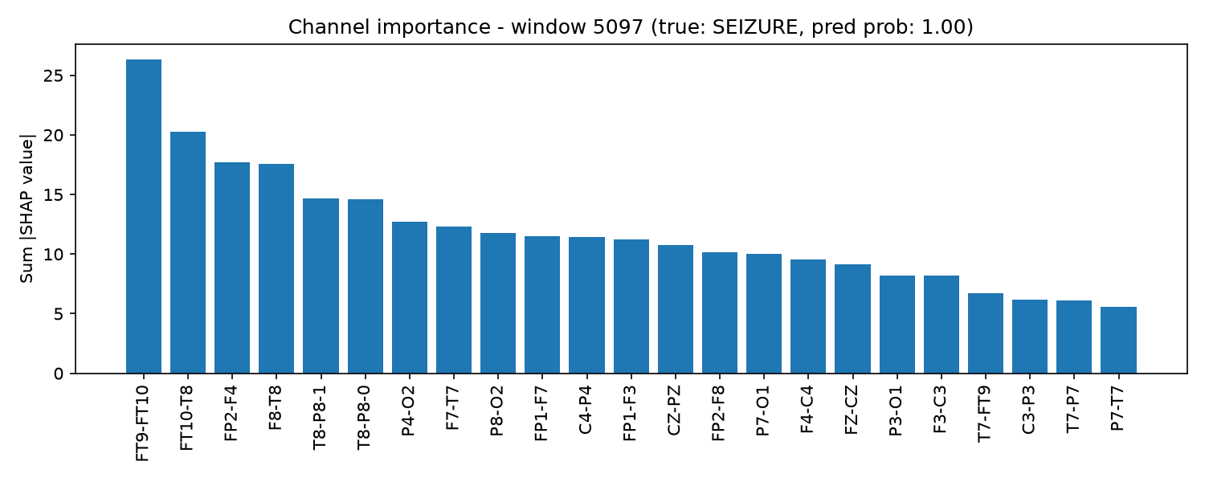
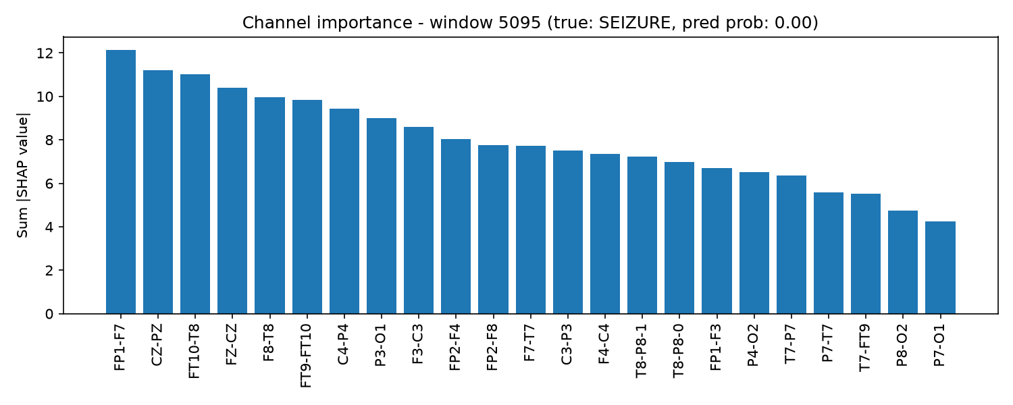
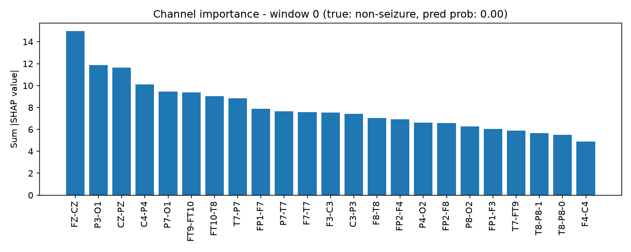
EXPLAINABILITY — THE CORE CONTRIBUTION
SHAP shows which electrodes drove each prediction
Correctly detected seizure
Missed seizure (false negative)
Correct non-seizure window
Model probability: 1.00
Model probability: 0.00
Model probability: 0.00
Each chart ranks all 23 EEG channels by how much they contributed to that specific prediction (SHAP GradientExplainer). Unlike a plain “seizure detected” alert, a clinician can see exactly which electrodes and moments drove the model's decision — including when it gets it wrong.
Honest inclusion of a missed seizure (center) — this project reports real failure cases, not only successes.

Slide 9
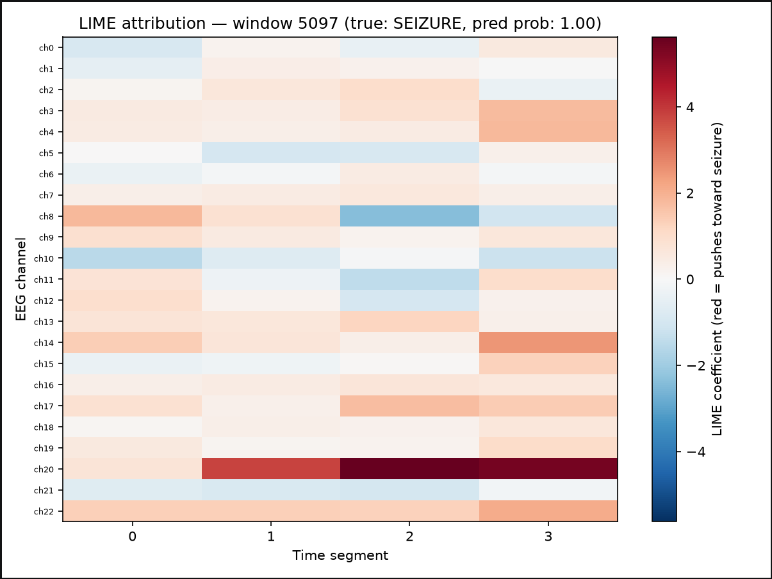
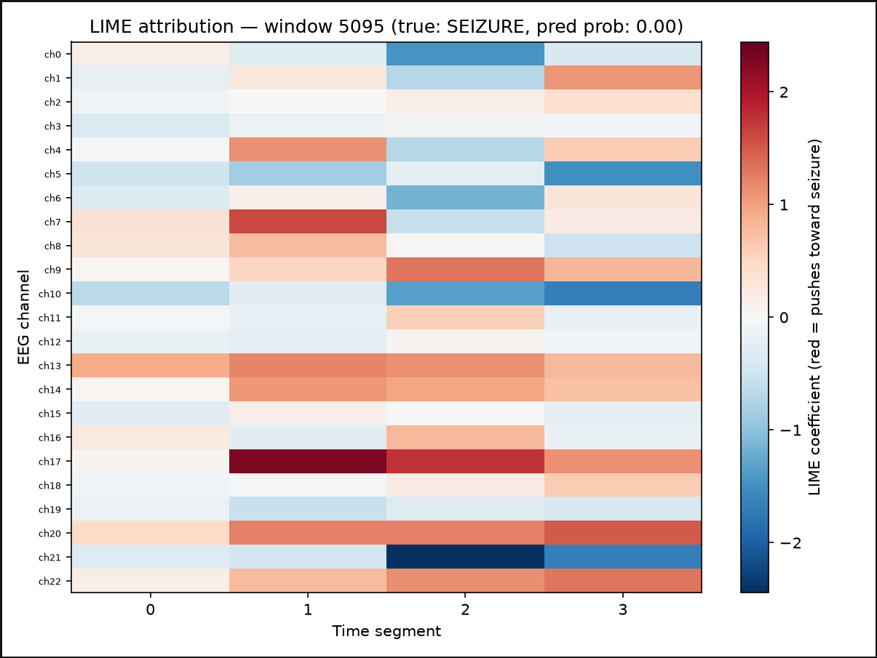
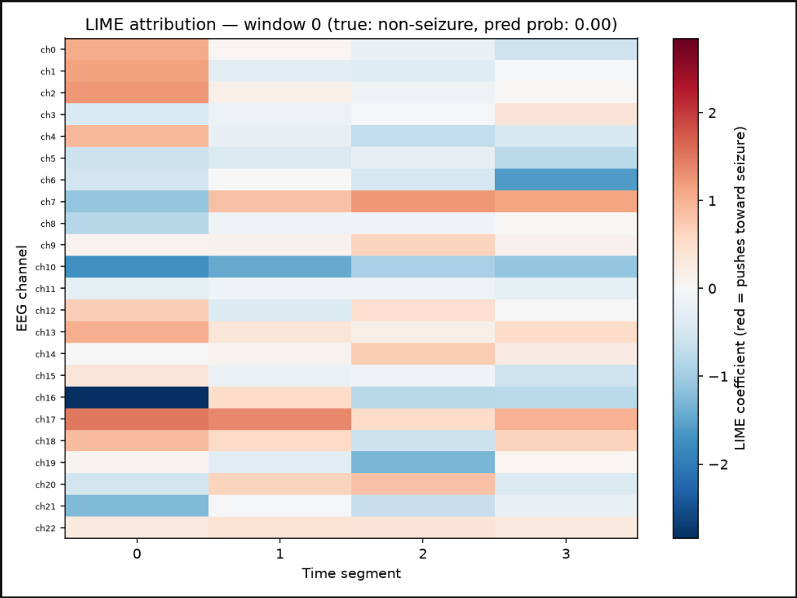
EXPLAINABILITY, CROSS-VALIDATED WITH LIME
A second, independent method — LIME — was added to check SHAP's story
Correctly detected seizure
Missed seizure (false negative)
Correct non-seizure window
Model probability: 1.00
Model probability: 0.00
Model probability: 0.00
LIME was implemented from scratch (no off-the-shelf time-series LIME exists): each window is segmented into channel × time-block regions, randomly masked, and a local surrogate model is fit to the real model's output to recover per-region importance — independent of how SHAP computes its scores.
SHAP and LIME independently agree on the top-ranked channel across every sampled seizure window — two unrelated methods converging is stronger evidence than either alone.

Slide 10
Thank You
Questions welcome — including about what broke along the way.
github.com/VivekA28/epilepsy-seizure-detection

